Slide 1
Employees Data Dashboard
Dashboard for management &HR decision Making
Created by: Manikumar Mathangi
Tool Used by: Power Bi

Slide 2
Business Objective
Track employee Distribution
Monitor Salary & bons costs
Evaluate department performance
Understand employee Satisfaction

Slide 3
Key KPIs Overview
Total employees : 25
Projects Completed : 295
Total Salary : ₹1.53M
Total bonus paid : ₹137.3K

Slide 4
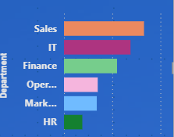
Projects completed by department
Sales & IT lead in productivity
HR & Operations have lower contribution
Helps management allocate workload

Slide 5
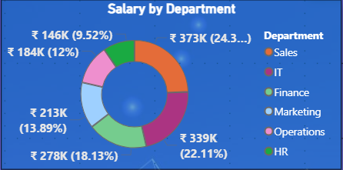
Salary distribution by Departments
IT & Sales have highest salary cost
HR has a lowest Salary
Useful for budget Planning

Slide 6
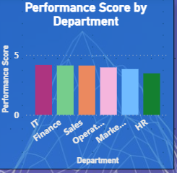
Performance Score Analysis
IT shows highest performance
HR needs improvement
Supports performance appraisal decisions

Slide 7
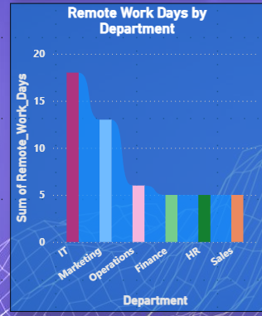
Remote Work Analysis
IT & Marketing use more remote days
Helps understand work culture trends

Slide 8
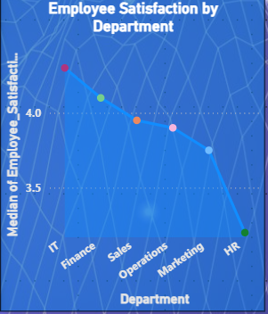
Employee Satisfaction Insights
IT has highest satisfaction
HR has lowest satisfaction
HR action required for retention

Slide 9
Key Business Insights
Sales is high performing but high cost
HR needs engagement improvement
Balanced salary vs performance needed

Slide 10
Conclusion
Dashboard supports strategic decisions
Useful for HR & management teams

Slide 11
THANK YOU

